Slide 1
Machine learning using python
2022. 11. 30

Slide 2

Medical AI overview
Reference: https://www.youtube.com/watch?v=VePHPymCy2U
Notes:
의료 인공지능
ARDS: 급성 호흡곤란 증후군

Slide 3
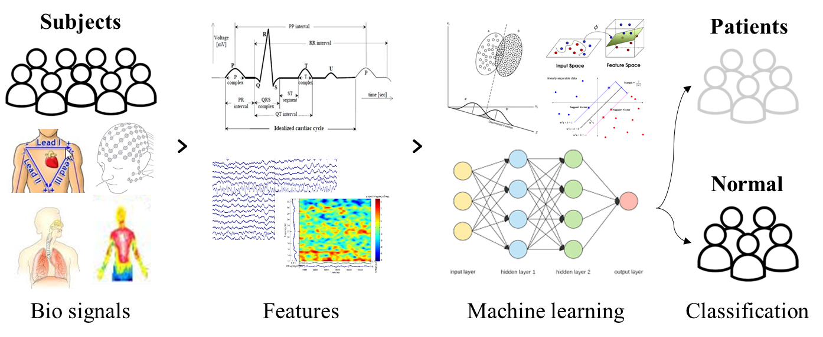
Medical AI overview
Electroencephalogram (EEG)
Notes:
의료 인공지능

Slide 4
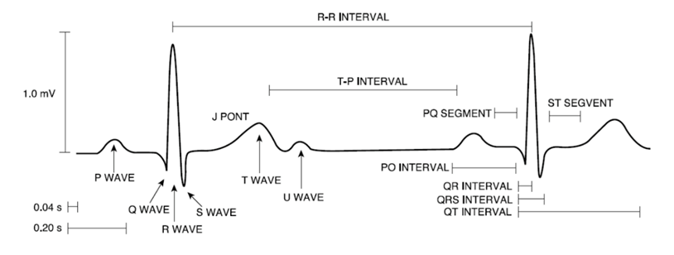
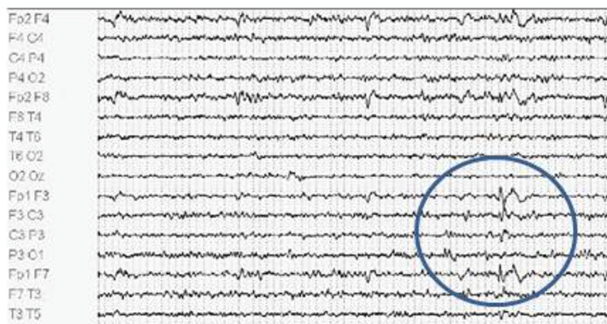
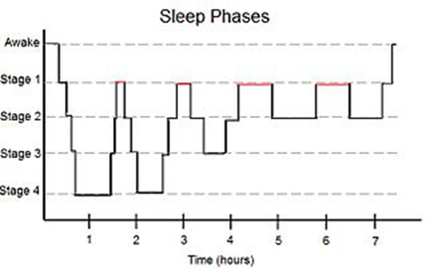
Machine learning in Biomedical Engineering
ML provides additional information for the doctors

Slide 5
Python flow chart
Flow chart
Data load
Feature selection
Cross-validation
Classification

Slide 6

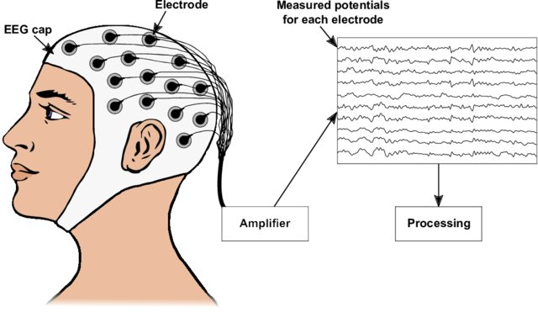
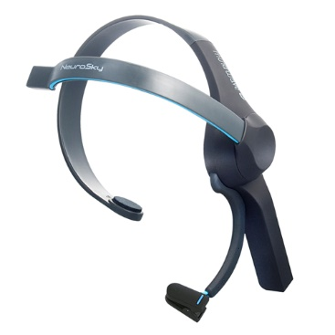
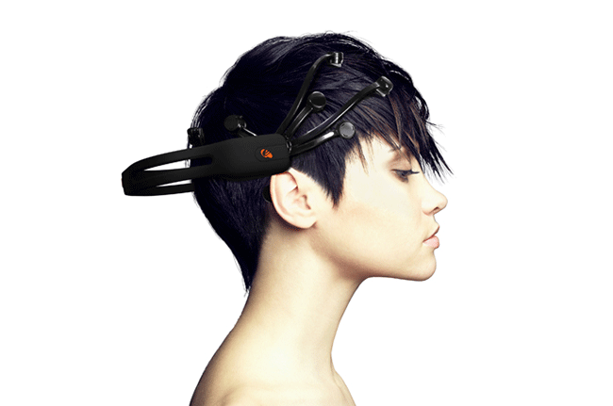
Electroencephalogram (EEG)
EEG
Nagel, S. (2019). Towards a home-use BCI: fast asynchronous control and robust non-control state detection (Doctoral dissertation, Universität Tübingen).

Slide 7
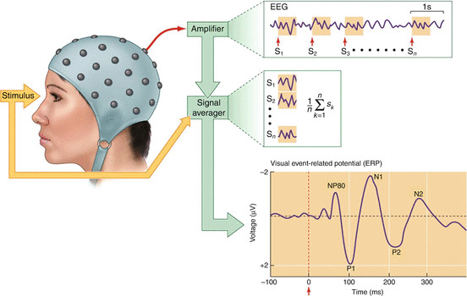
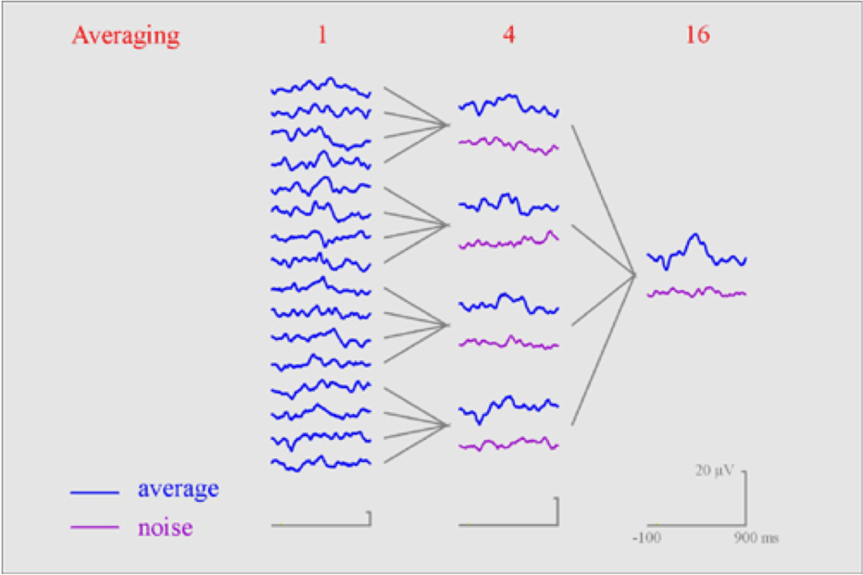
Electroencephalogram (EEG)
Event related potential (ERP)
http://www.eegget-it.nl/erp.html
https://balaslab.wordpress.com/2015/07/30/what-is-eeg-part-2-from-eeg-to-erp/

Slide 8

Schizophrenia
Clarke, Jodi. (12/08/2019). The Signs and Symptoms of Schizophrenia. Verywellmind.com. https://www.verywellmind.com/what-are-the-symptoms-of-schizophrenia-2953120.

Slide 9
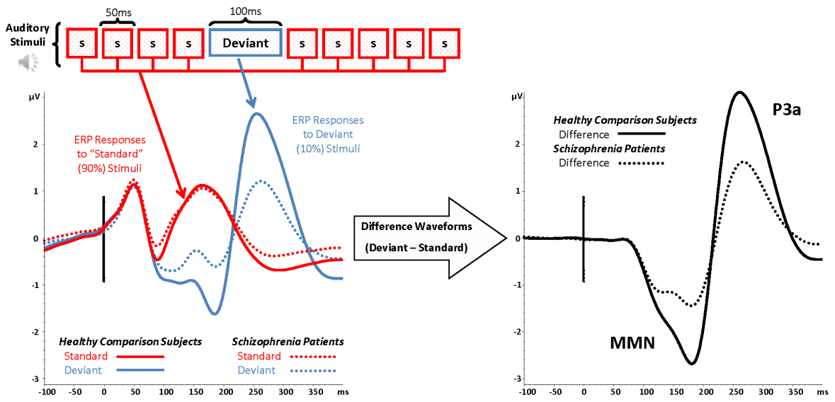
Mismatch negativity
Mismatch negativity (MMN)
Measure of pre-attentive auditory change detection
Index of cognitive decline
Abnormalities found in schizophrenia
Light, G. A. et al., 2015

Slide 10

Mismatch negativity
Participants
Auditory stimuli and procedures
Watching Charlie Chaplin movie without paying attention to auditory stimuli
750 auditory stimuli with an interstimulus interval of 500 ms
Standard tones 50 ms (90%)
Deviant tones 100 ms (10%)
Schizophrenia
Healthy control
N = 30
Age: 42.70 ± 10.96
N = 30
Age: 43.83 ± 13.18
50 ms
500 ms
100 ms
Auditory stimuli
S
S
S
S
Deviant
S
S
S
S
S
Standard
Deviant

Slide 11
Mismatch negativity
Recording and preprocessing of electroencephalography (EEG)
EEG data
Visual inspection for gross artifacts
Ocular artifact reduction
Filtering (0.1-30 Hz)
Epoching (-100~600 ms)
Baseline correction (pre-stimulus)
Artifact rejection (exceeding ± 75 µv)
Averaging for ERP analysis
Generating MMN wave (deviant – standard)
Calculating MMN amplitude
* EEG recorded using NeuroScan SynAmps amplifier with 62 Ag-AgCl electrodes
* MMN amplitude measured as the mean voltage between 130 and 280 ms at nine electrode sites (F3, Fz, F4, FC3, FCz, FC4, C3, Cz, and C4)

Slide 12
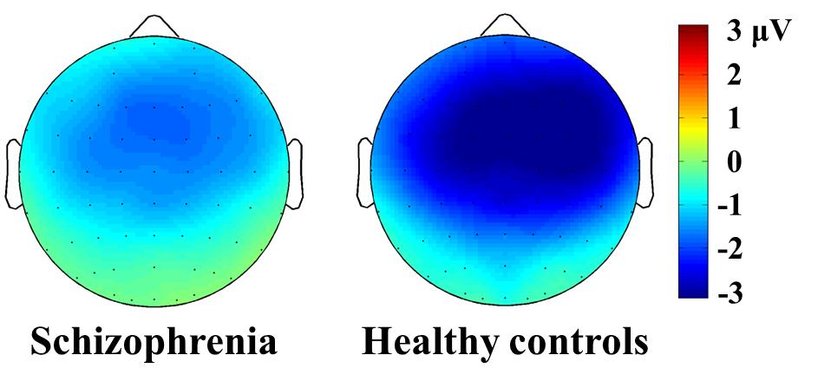
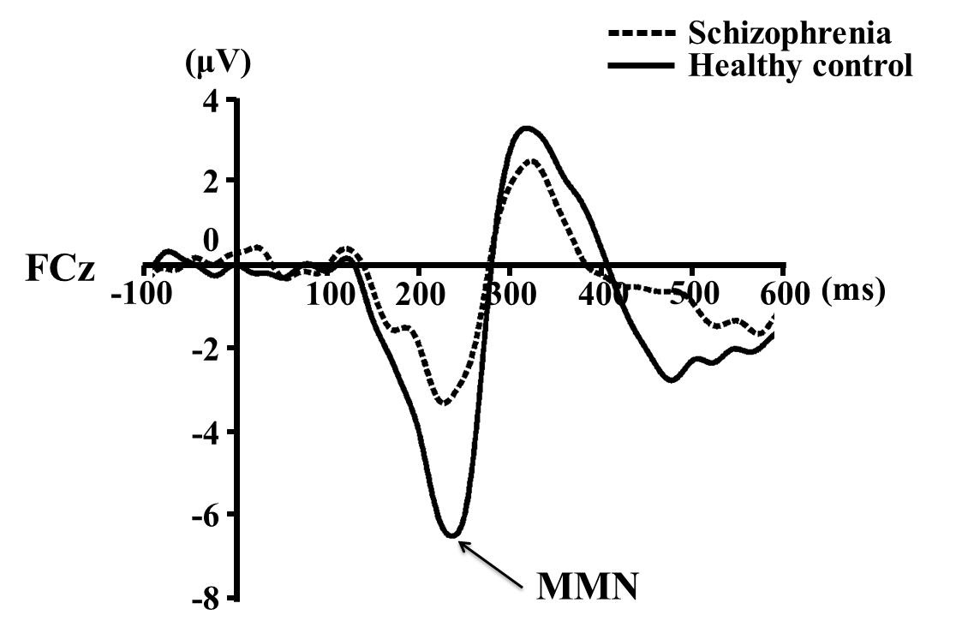
Mismatch negativity

Slide 13
Python flow chart
Flow chart
Data load
Feature selection
Cross-validation
Classification

Slide 14
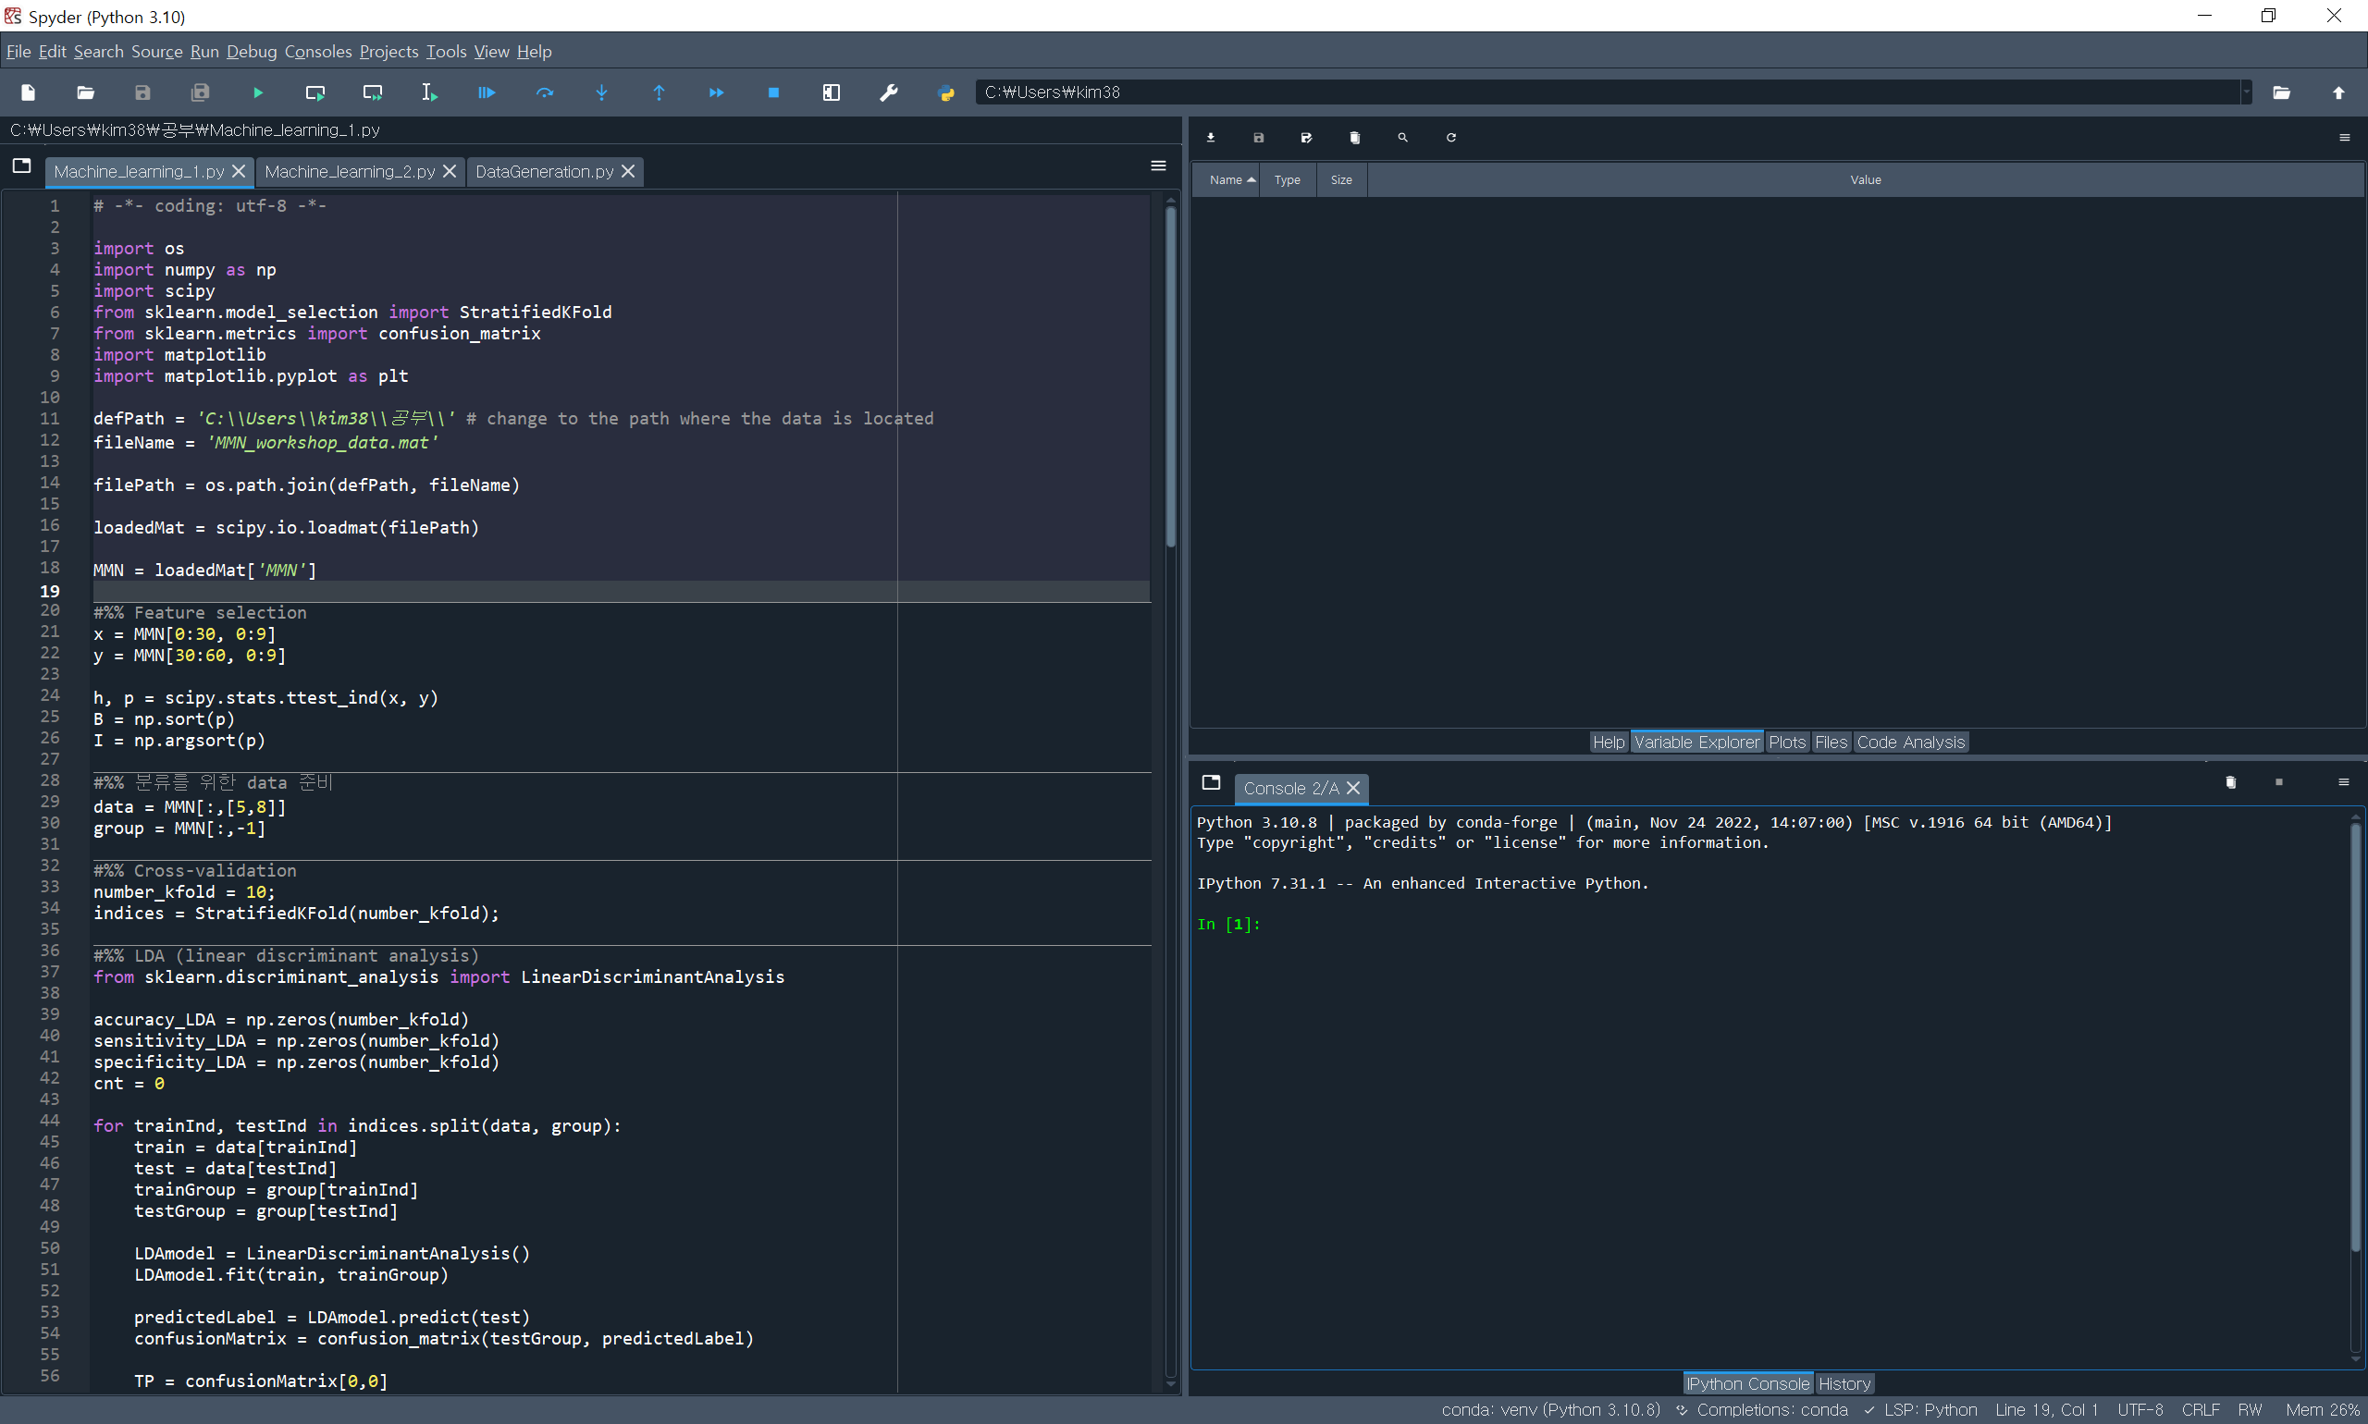
Spyder
Current directory
Editor
Work space
(variable, plots, etc.)
Console

Slide 15
python
Package & Data load
Make ‘workshop_221130’ folder on C drive
Download workshop data on ‘C:\workshop_221130’
Ctrl + enter key: run section
Shift + enter key: run section & select next section
F9: run selected codes
import os
import numpy as np
import scipy
from sklearn.model_selection import StratifiedKFold
from sklearn.metrics import confusion_matrix
import matplotlib
import matplotlib.pyplot as plt

Slide 16
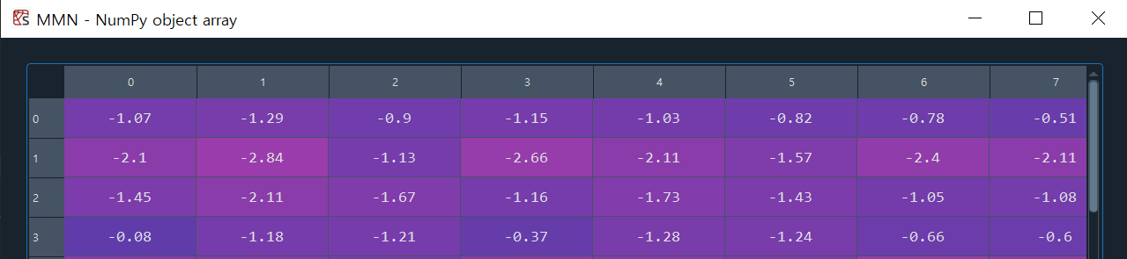
python
Package & Data load
Make ‘workshop_221130’ folder on C drive
Download workshop data on ‘C:\workshop_221130’
defPath = 'C:\\workshop_221130\\' # change to the path where the data is located
fileName = 'MMN_workshop_data.mat'
filePath = os.path.join(defPath, fileName)
loadedMat = scipy.io.loadmat(filePath)
MMN = loadedMat['MMN']

Slide 17
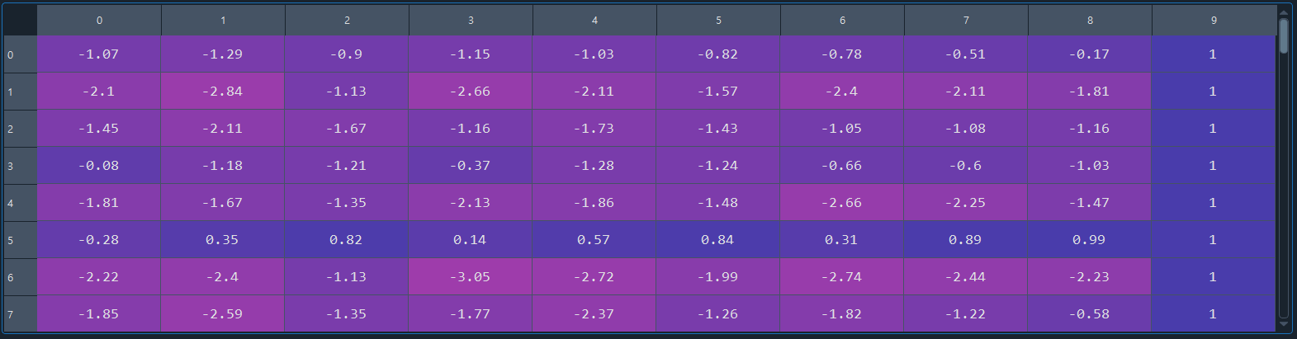
python
Data load
row: subject, column: features (each channel’s MMN amplitude) and group label
row 0~29: Schizophrenia, row 30~59: Healthy subject
column 0~8: F3, Fz, F4, FC3, FCz, FC4, C3, Cz, C4,
column 9: group label (1: schizophrenia, 2: healthy subject)

Slide 18
Python flow chart
Flow chart
Data load
Feature selection
Cross-validation
Classification

Slide 19
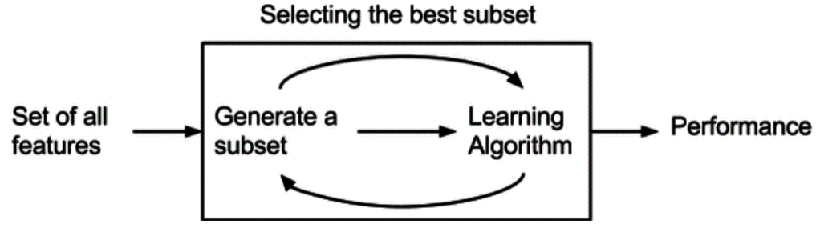
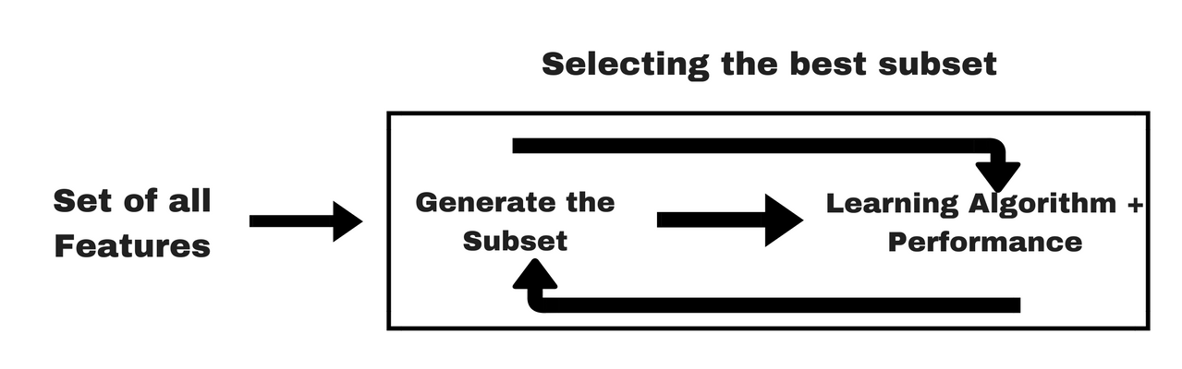
Feature selection
Feature selection is the process of reducing the number of input variables when developing a predictive model
To reduce the computational cost of modeling
To understand model more precisely
1) Filter method
2) Wrapper method
3) Embedded method

Slide 20
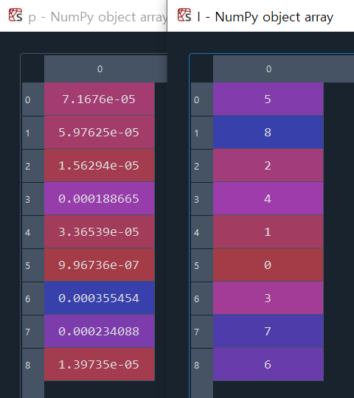
python
Feature selection
Find the p-value for each of the 9 features for a 2-sample t-test
Select the top two features based on the p-value
x = MMN[0:30, 0:9] % MMN amplitude (Schizophrenia)
y = MMN[30:60, 0:9] % MMN amplitude (Healthy)
h, p = scipy.stats.ttest_ind(x, y) % Find the p-value for a 2-sample t-test
B = np.sort(p) % Sort 9 p-values in ascending order
I = np.argsort(p)

Slide 21
python
Feature selection
Features 5 and 8 (FC4, C4 channels) best represent the statistical difference between the two groups

Slide 22
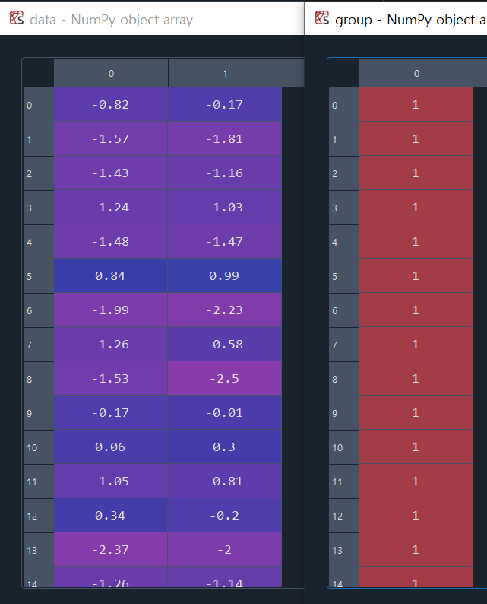
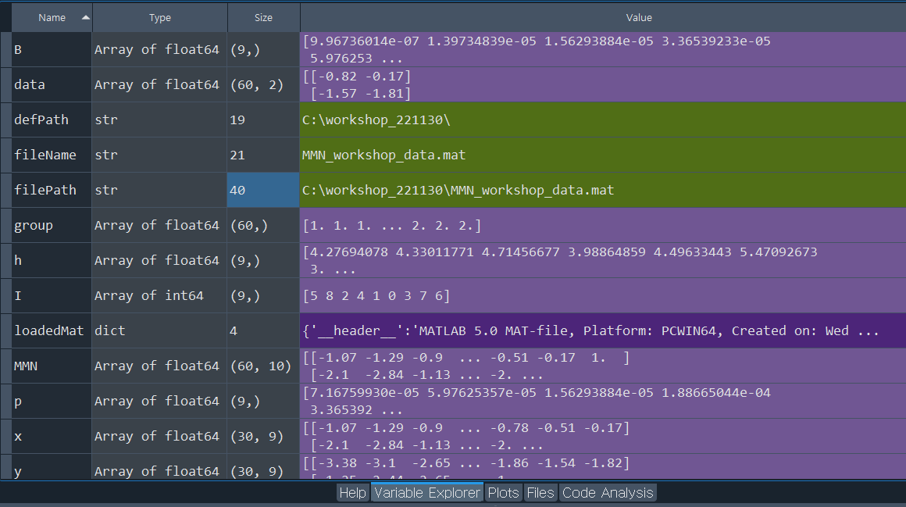
python
Classification data preparation
data = MMN[:,[5,8]] % Reconstruct data using only features 5 and 8 (FC4, C4 channels)
group = MMN[:,-1] % Create a group variable using only the group label

Slide 23
Python flow chart
Flow chart
Data load
Feature selection
Cross-validation
Classification

Slide 24
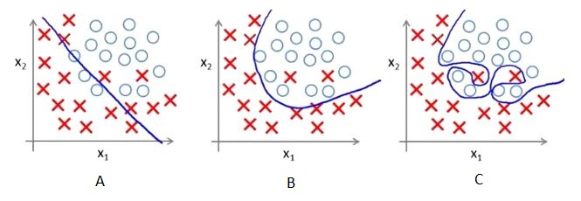
Overfitting
The production of an analysis that corresponds too closely or exactly to a particular set of data
Fail to fit additional data or predict future observations reliably

Slide 25
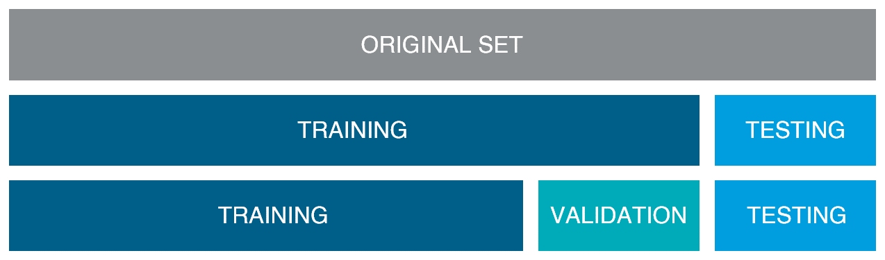
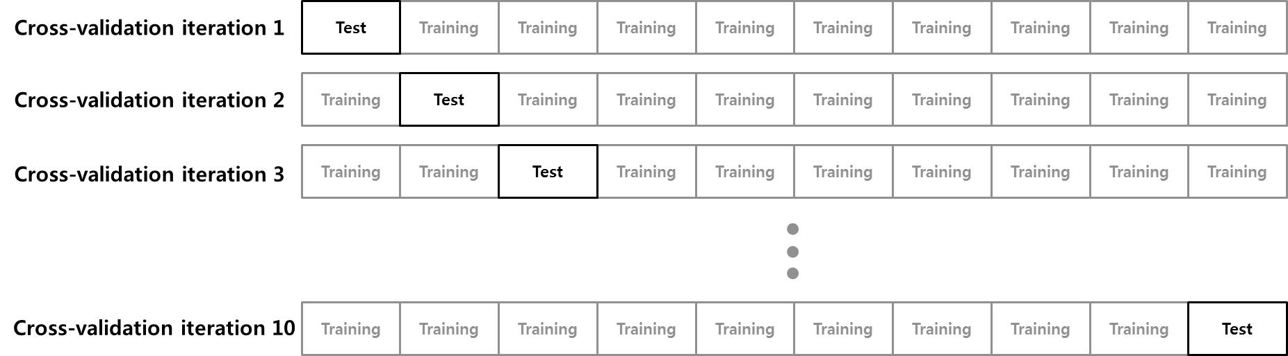
Cross-validation
Training – Validation – Test set
10-fold cross-validation

Slide 26
python
Cross-validation
Assign a fold number to each subject
6 people per fold (schizophrenia: 3 persons, healthy: 3 persons)
number_kfold = 10; % Set the number of folds
indices = StratifiedKFold(number_kfold); % Randomly place group labels on each fold using group labels and number of folds

Slide 27
Python flow chart
Flow chart
Data load
Feature selection
Cross-validation
Classification

Slide 28
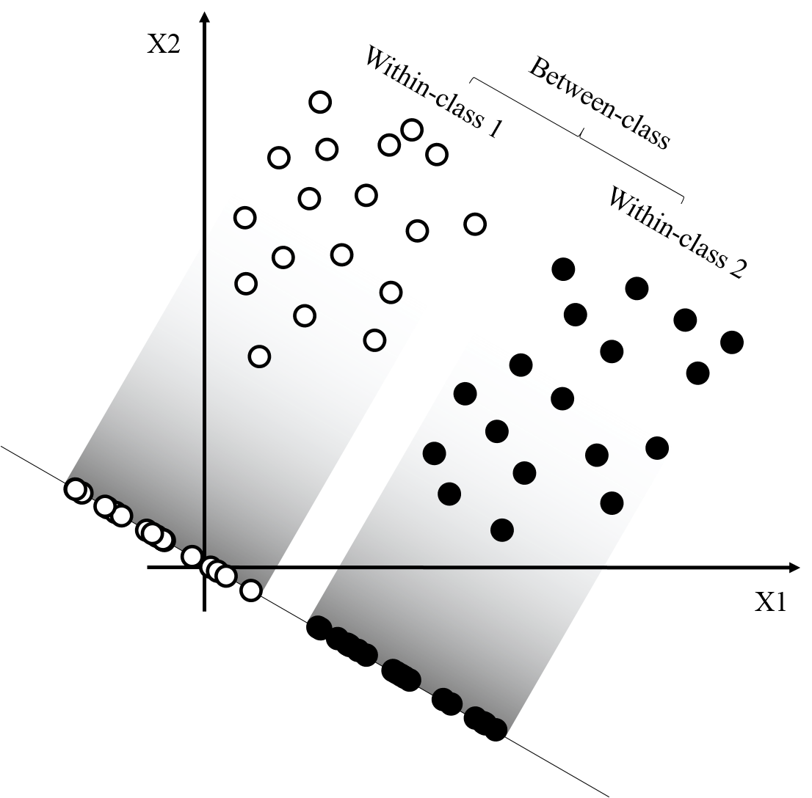
Classifiers
Linear discriminant analysis (LDA)

Slide 29
python
LDA (linear discriminant analysis)
from sklearn.discriminant_analysis import LinearDiscriminantAnalysis
accuracy_LDA = np.zeros(number_kfold) % Initialization
sensitivity_LDA = np.zeros(number_kfold)
specificity_LDA = np.zeros(number_kfold)
cnt = 0

Slide 30
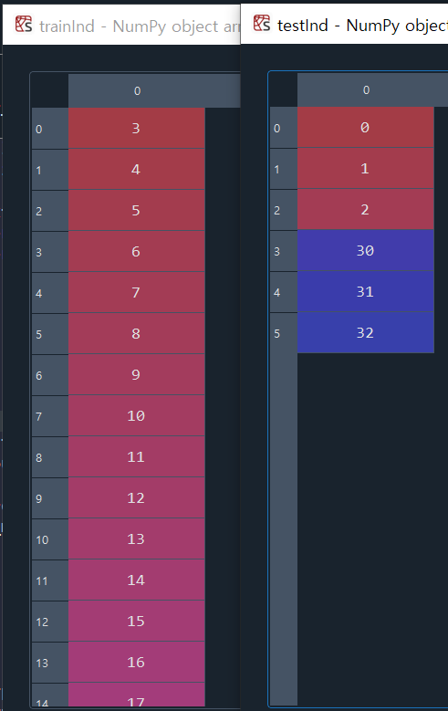
python
LDA (linear discriminant analysis)
for trainInd, testInd in indices.split(data, group): % Execute the following commands from the 1st fold to the 10th fold sequentially
train = data[trainInd] % Set the other folds as training data
test = data[testInd] % Set a fold as test data
trainGroup = group[trainInd]
testGroup = group[testInd]

Slide 31
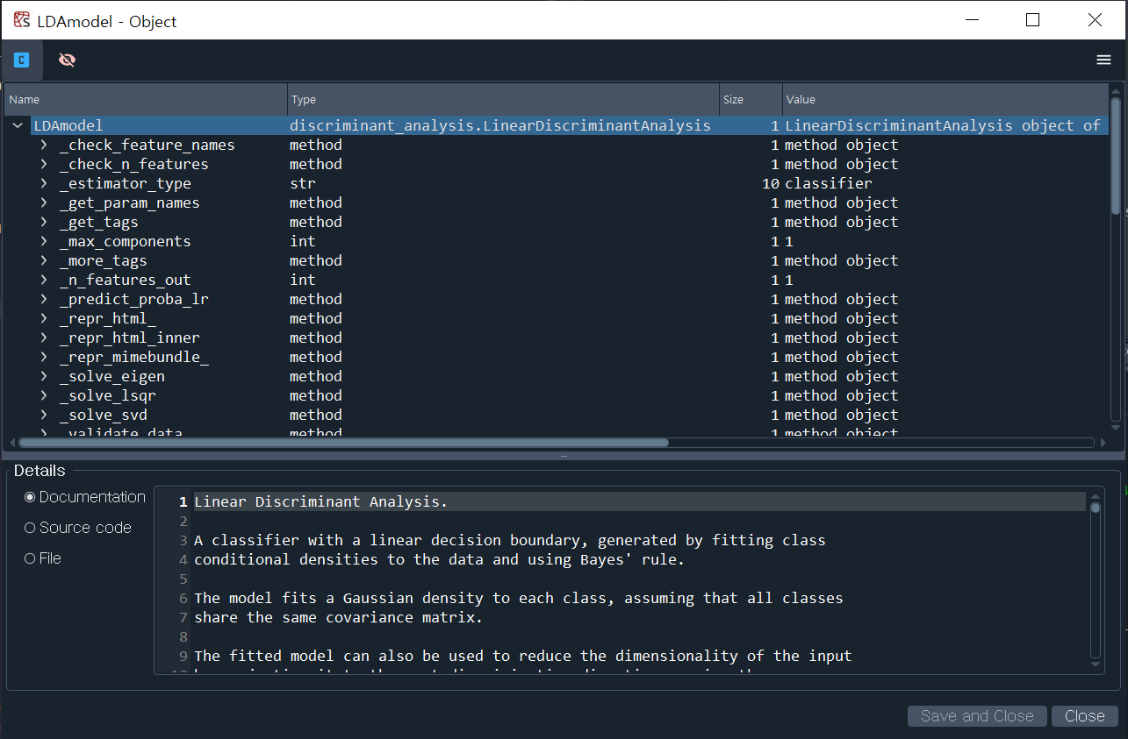
python
LDA (linear discriminant analysis)
LDAmodel = LinearDiscriminantAnalysis()
LDAmodel.fit(train, trainGroup) % Create an LDA model using training data

Slide 32
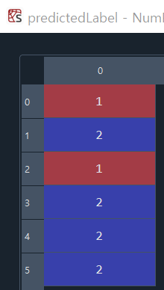
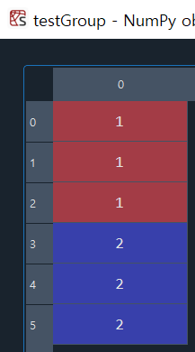
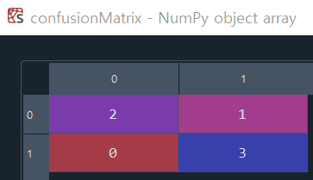
python
LDA (linear discriminant analysis)
predictedLabel = LDAmodel.predict(test)
% Predict the group label of the test data based on the LDA model generated using the training data
confusionMatrix = confusion_matrix(testGroup, predictedLabel)
% Create a confusion matrix using predicted group labels and actual group labels of the test data.

Slide 33
Performance metric
Confusion matrix
Accuracy = (TP + TN) / (TP + FP + FN + TN)
Sensitivity = TP / (TP + FN)
Specificity = TN / (TN + FP)
Actual label
TP
True Positive
FP
False Positive
TP: classify patient as patient
TN: classify healthy as healthy
FP: classify healthy as patient
FN: classify patient as healthy
Predicted label
FN
False Negative
TN
True Negative

Slide 34
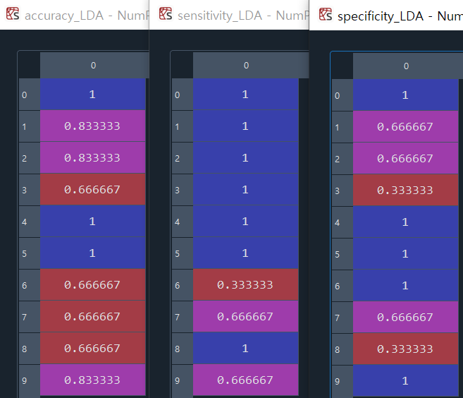
python
LDA (linear discriminant analysis)
TP = confusionMatrix[0,0]
TN = confusionMatrix[1,1]
FP = confusionMatrix[1,0]
FN = confusionMatrix[0,1]
accuracy_LDA[cnt] = (TP+TN)/(TP+FP+FN+TN) % Calculate accuracy using confusion matrix
sensitivity_LDA[cnt] = TP/(TP+FN) % Calculate sensitivity using confusion matrix
specificity_LDA[cnt] = TN/(TN+FP) % Calculate specificity using confusion matrix
cnt += 1

Slide 35
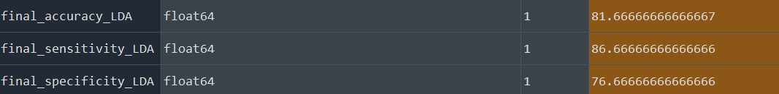
python
LDA (linear discriminant analysis)
final_accuracy_LDA = np.mean(accuracy_LDA)*100 % Average test data accuracy of 10 folds
final_sensitivity_LDA = np.mean(sensitivity_LDA)*100 % Average test data sensitivity of 10 folds
final_specificity_LDA = np.mean(specificity_LDA)*100 % Average test data specificity of 10 folds

Slide 36
python
LDA (linear discriminant analysis)
X0, X1 = data[group==1], data[group==2]
plt.scatter(X0[:,0], X0[:, 1], color="red") % scatter data on feature space (2D)
plt.scatter(X1[:,0], X1[:, 1], color="blue")
xlimit = [-8.2, 1.3]
ylimit = [-8.2, 1.3]
x_min, x_max = xlimit[0], xlimit[1]
y_min, y_max = ylimit[0], ylimit[1]
plt.xlim(xlimit); plt.ylim(ylimit)
xx, yy = np.meshgrid(np.linspace(x_min, x_max, 2000), np.linspace(y_min, y_max, 2000))
Z = LDAmodel.predict_proba(np.c_[xx.ravel(), yy.ravel()])
Z = Z[:, 1].reshape(xx.shape) >= 0.5
cmap = matplotlib.colormaps['Pastel1']
plt.pcolormesh(xx, yy, Z, cmap=cmap , zorder=0)
plt.contour(xx, yy, Z, [0.5], linewidths=2.0) % plot decision boundary

Slide 37
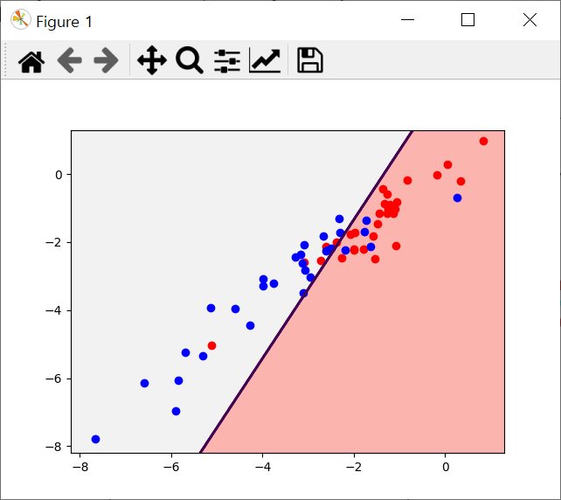
python
LDA (linear discriminant analysis)

Slide 38
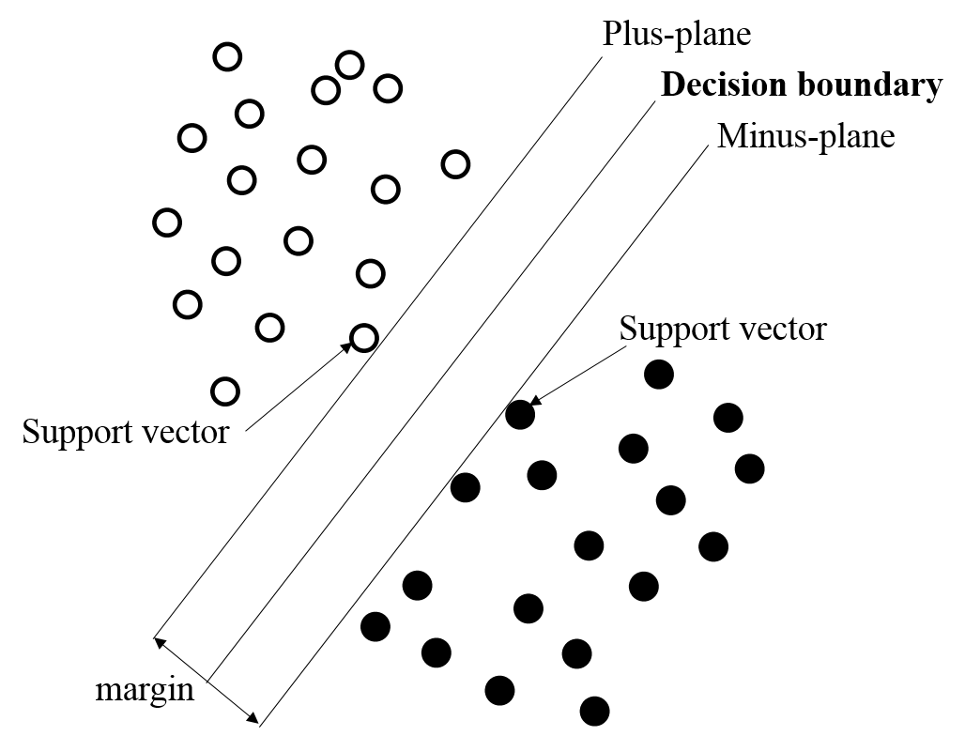
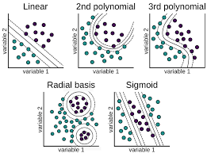
Classifiers
Support vector machine (SVM)

Slide 39
python
SVM (support vector machine)
from sklearn import svm
accuracy_SVM = np.zeros(number_kfold) % Initialization
sensitivity_SVM = np.zeros(number_kfold)
specificity_SVM = np.zeros(number_kfold)
cnt = 0

Slide 40
python
SVM (support vector machine)
for trainInd, testInd in indices.split(data, group): % Execute the following commands from the 1st fold to the 10th fold sequentially
train = data[trainInd] % Set the other folds as training data
test = data[testInd] % Set a fold as test data
trainGroup = group[trainInd]
testGroup = group[testInd]

Slide 41
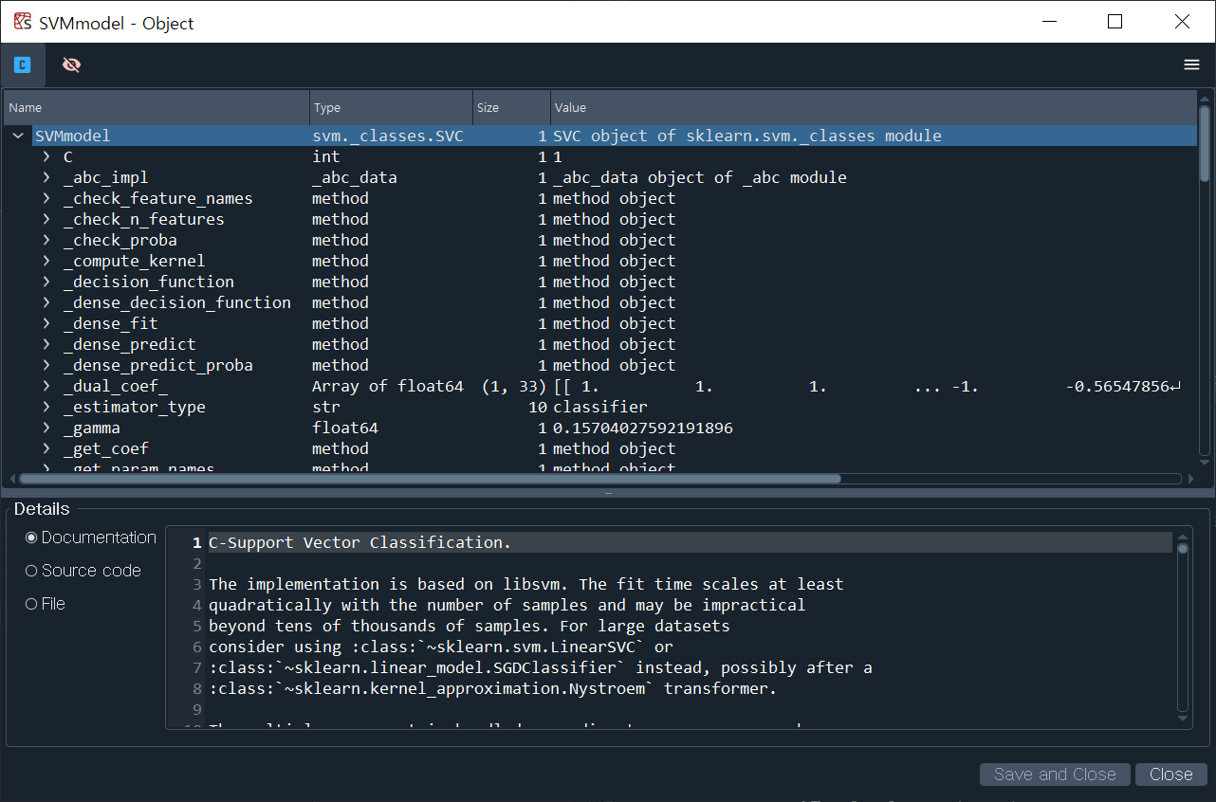
python
SVM (support vector machine)
SVMmodel = svm.LinearSVC(C=1, max_iter=10000) % Create an linear SVM model using training data
SVMmodel.fit(train, trainGroup)

Slide 42
python
SVM (support vector machine)
predictedLabel = SVMmodel.predict(test)
% Predict the group label of the test data based on the SVM model generated using the training data
confusionMatrix = confusion_matrix(testGroup, predictedLabel)
% Create a confusion matrix using predicted group labels and actual group labels of the test data.

Slide 43
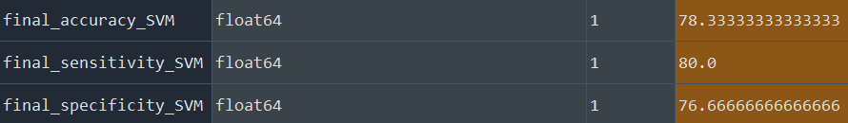
python
SVM (support vector machine)
TP = confusionMatrix[0,0]
TN = confusionMatrix[1,1]
FP = confusionMatrix[1,0]
FN = confusionMatrix[0,1]
accuracy_SVM[cnt] = (TP+TN)/(TP+FP+FN+TN) % Calculate accuracy using confusion matrix
sensitivity_SVM[cnt] = TP/(TP+FN) % Calculate sensitivity using confusion matrix
specificity_SVM[cnt] = TN/(TN+FP) % Calculate specificity using confusion matrix
cnt += 1
final_accuracy_SVM = np.mean(accuracy_SVM)*100
final_sensitivity_SVM = np.mean(sensitivity_SVM)*100
final_specificity_SVM = np.mean(specificity_SVM)*100

Slide 44
python
SVM (support vector machine)
from sklearn.inspection import DecisionBoundaryDisplay
X0, X1 = data[group==1], data[group==2]
DecisionBoundaryDisplay.from_estimator(SVMmodel, data, ax=plt.gca(),
grid_resolution=2000, response_method="predict", cmap=plt.cm.Pastel1,
alpha=0.8)
plt.scatter(X0[:,0], X0[:, 1], color="red") % scatter data on feature space (2D)
plt.scatter(X1[:,0], X1[:, 1], color="blue")
xlimit = [-8.2, 1.3]
ylimit = [-8.2, 1.3]
plt.xlim(xlimit); plt.ylim(ylimit)
decision_function = SVMmodel.decision_function(data)
support_vector_indices = np.where(np.abs(decision_function) <= 1 + 1e-15)[0]
support_vectors = data[support_vector_indices]
plt.scatter(support_vectors[:,0], support_vectors[:,1], s=100, facecolor="none", edgecolors="k")
DecisionBoundaryDisplay.from_estimator(SVMmodel, data, ax=plt.gca(), % plot decision boundary
grid_resolution=50, plot_method="contour", levels=[-1, 0, 1],
colors="k", alpha=0.5, linestyles=["--", "-", "--"])

Slide 45
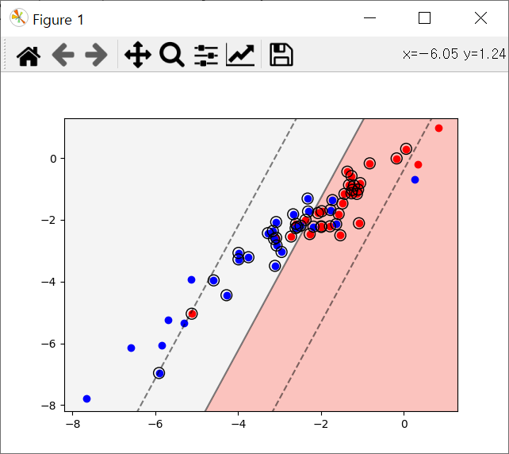
python
SVM (support vector machine)
Linear kernel SVM

Slide 46
python
SVM (support vector machine)
SVMmodel = svm.SVC(C=1, kernel="poly", degree=2)
% Create an 2nd polynomial model using training data
SVMmodel = svm.SVC(C=1, kernel="poly", degree=3)
% Create an 3rd polynomial model using training data
SVMmodel = svm.SVC(C=1, kernel="rbf")
% Create an radial basis function kernel model using training data

Slide 47
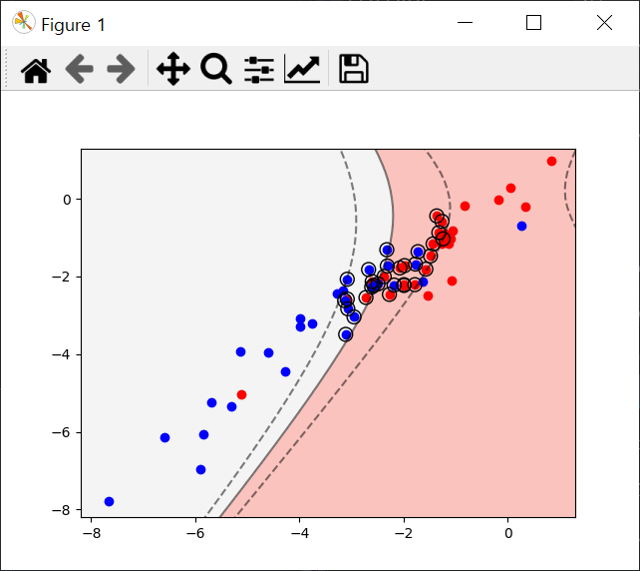
python
SVM (support vector machine)
2nd polynomial kernel SVM

Slide 48
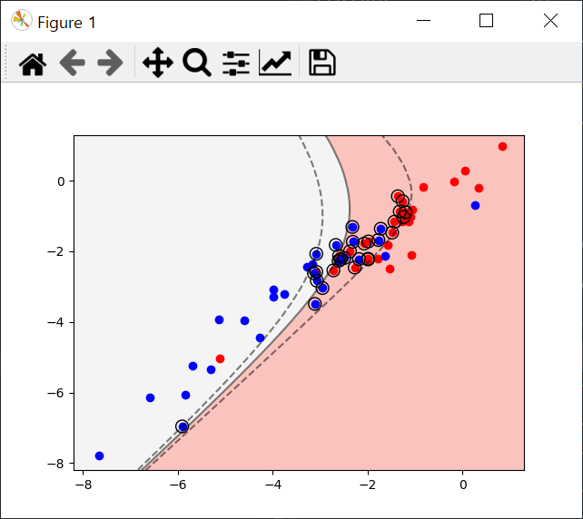
python
SVM (support vector machine)
3rd polynomial kernel SVM

Slide 49
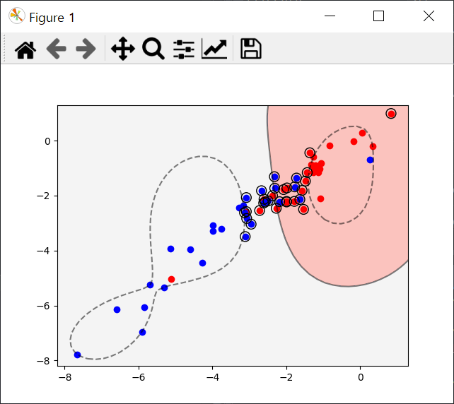
python
SVM (support vector machine)
Radial basis kernel SVM

Slide 50
python
SVM (support vector machine)
def SVMplot(SVMmodel, data, group): % define function
X0, X1 = data[group==1], data[group==2]
DecisionBoundaryDisplay.from_estimator(SVMmodel, data, ax=plt.gca(),
grid_resolution=2000, response_method="predict", cmap=plt.cm.Pastel1,
alpha=0.8)
plt.scatter(X0[:,0], X0[:, 1], color="red")
plt.scatter(X1[:,0], X1[:, 1], color="blue")
xlimit = [-8.2, 1.3]
ylimit = [-8.2, 1.3]
plt.xlim(xlimit); plt.ylim(ylimit)
decision_function = SVMmodel.decision_function(data)
support_vector_indices = np.where(np.abs(decision_function) <= 1 + 1e-15)[0]
support_vectors = data[support_vector_indices]
plt.scatter(support_vectors[:,0], support_vectors[:,1], s=100, facecolor="none", edgecolors="k")
DecisionBoundaryDisplay.from_estimator(SVMmodel, data, ax=plt.gca(),
grid_resolution=50, plot_method="contour", levels=[-1, 0, 1],
colors="k", alpha=0.5, linestyles=["--", "-", "--"])
% function end
SVMplot(SVMmodel, data, group)

Slide 51
Thanks for your attention!

